Slide 1

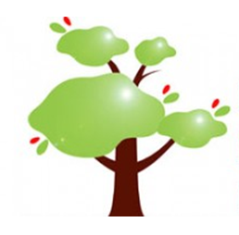
ALFIE – Alphabetisation for Immigrants to Europe
Hanne Christensen, Vox, NO

Slide 2
About ALFIE
Grundtvig Partnership
Explore issues concerning alphabetisation for adult immigrants (initial literacy )
Lack of
  research results
  good didactic models
  national systems for teacher training.
Project meetings / study visits

Slide 3
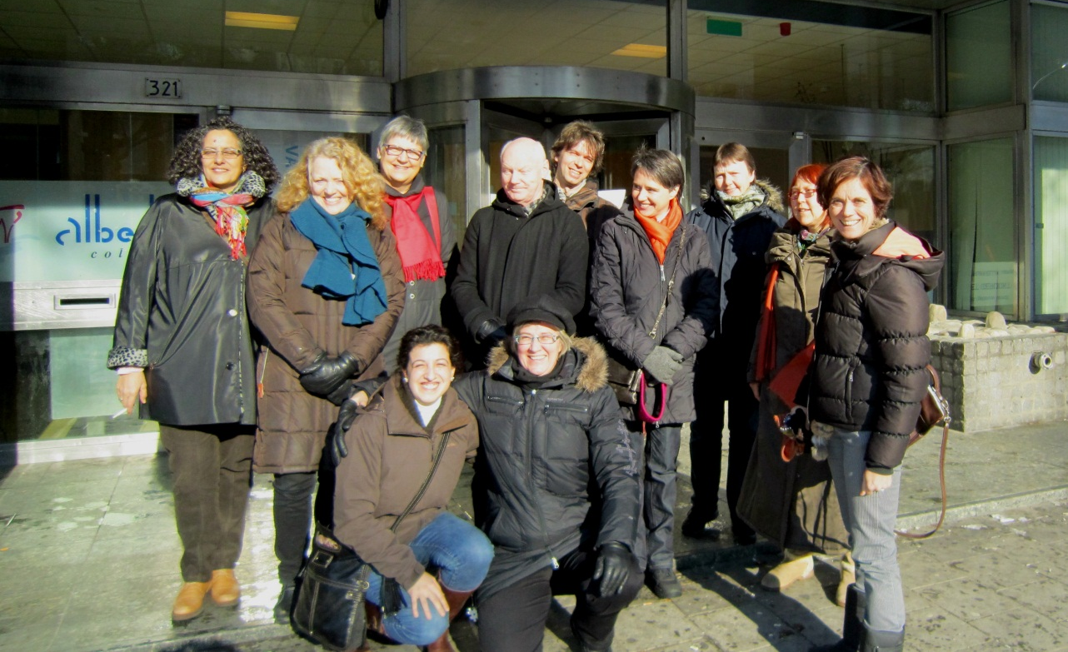
Partners
ongoing work
Albeda College, NL
ACEFIR, ES
Akrotea.ch, CH
University of Iceland, School of Education, IS
Vox, NO (co-ord.)
complement each other

Slide 4
A meeting place for the exchange of knowledge, experience, insights and practical models for initial literacy training
Strengths and weaknesses in the implemen-tation
Successful and transferable approaches, models and tools
Professionalisation of teaching staff – models, approaches, improvement
Recommendations for further study, research and development

Slide 5
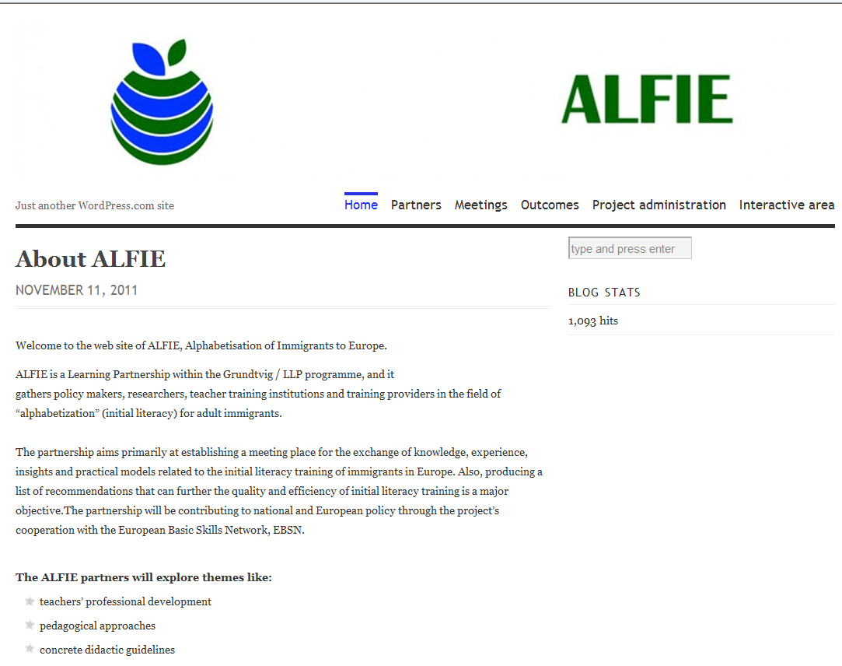
Dissemination
hanne.christensen@vox.no
Shared responsibility to inform & exchange
The website: http://alfieproject.wordpress.com/
- or via the EBSN website

