Slide 1
Writing your way to reading
Report from a pilot project

Slide 2
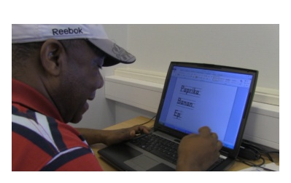
The method
sounding keyboard
-digital software connected to the keyboard
-when writing a voice is pronouncing the sound of each letter
speech synthesizer
-each word/sentences are read out loud
Background
Arne Trageton - Norway
Mona Wiklander – Sweden

Slide 3
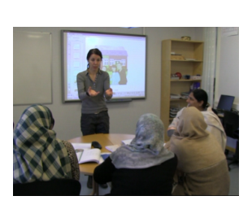
The pilot project
2 schools
Second Language Learners with little education
- Adults with no reading or
writing experiences in any
language

Slide 4
17 youth (16-19)
4 boys/13 girls
9 from Somalia
2 from Afghanistan
Thailand, Irak, Kurdistan
Underage asylumseeker arriving alone
Family reunion
15 adults (26-64)
5 men/10 women
5 from Pakistan
4 from Somalia
2 from Afghanistan
Marocco, Kurdistan, Sudan, Greece
Political refugees
Family reunion
Immigrants for work

Slide 5
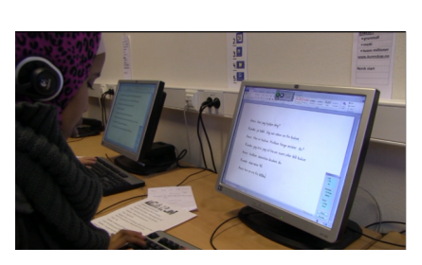
Experiences so far
increased fokus on oral teaching
linguistic awareness of the relationship between
sound and letter
increased digital competence
active learners
motivating
facilitates for individual adaptation

